Slide 1




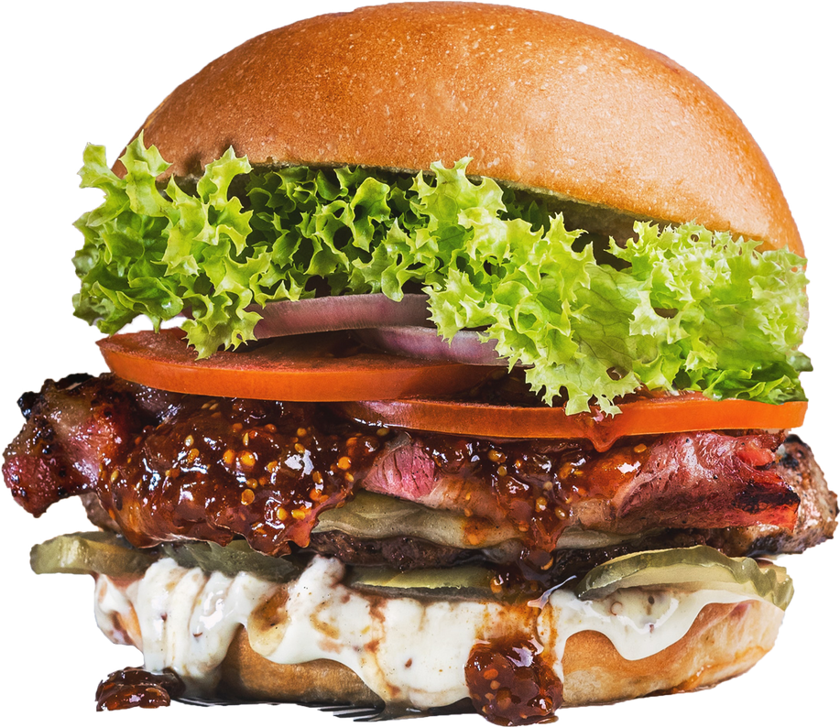
MCDONALD’S SALES DASHBOARD
PROJECT
By Parul Kokcha

Slide 2

ABOUT
US
McDonald's is a global fast-food chain known for its hamburgers, french fries, and other menu items. It operates over 40,000 restaurants in more than 100 countries. The company is also a major employer, with over 1.7 million employees worldwide, many of whom work at franchise locations.

Slide 3


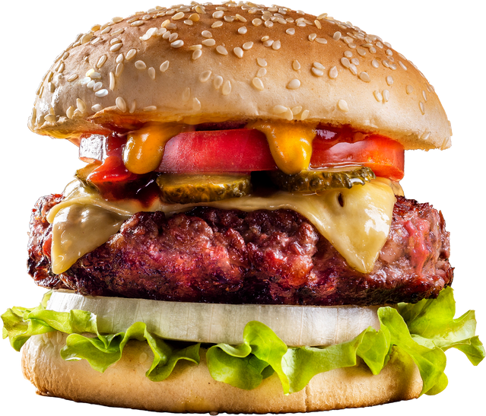


PROJECT OBJECTIVE
>
This project delivers actionable insights through analysis of customer preferences, and time-based trends using an interactive dashboard,focusing on:
Analyzing customer behavior to refine marketing.
Idebtifying top-selling products for targeted strategies.
Enhancing operational efficiency through data-backed recommendations.
Enabling strategic decisions for revenue growth.
Order Now
>

Slide 4

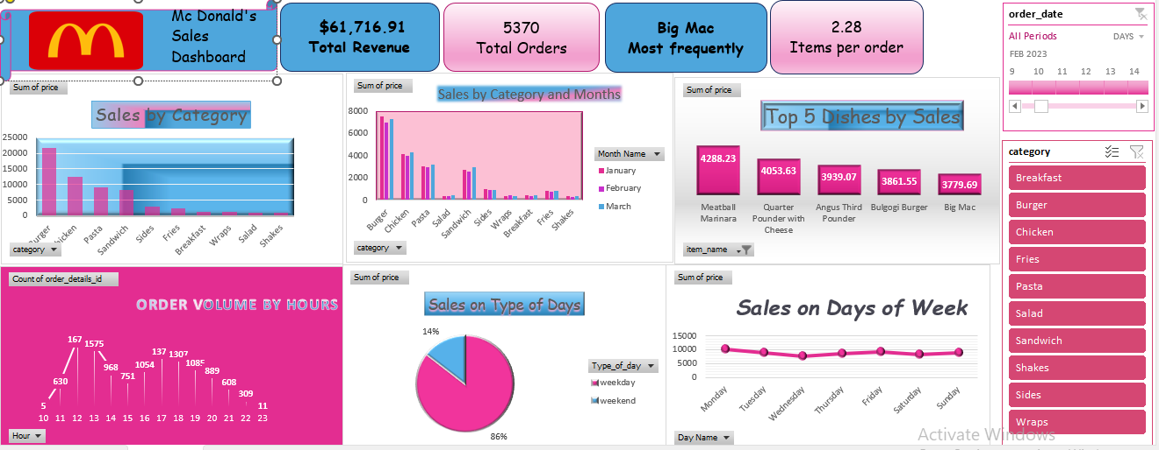
February 2023 McDonald’s Sales Overview:
Performance Trends and Key Drivers

Slide 5
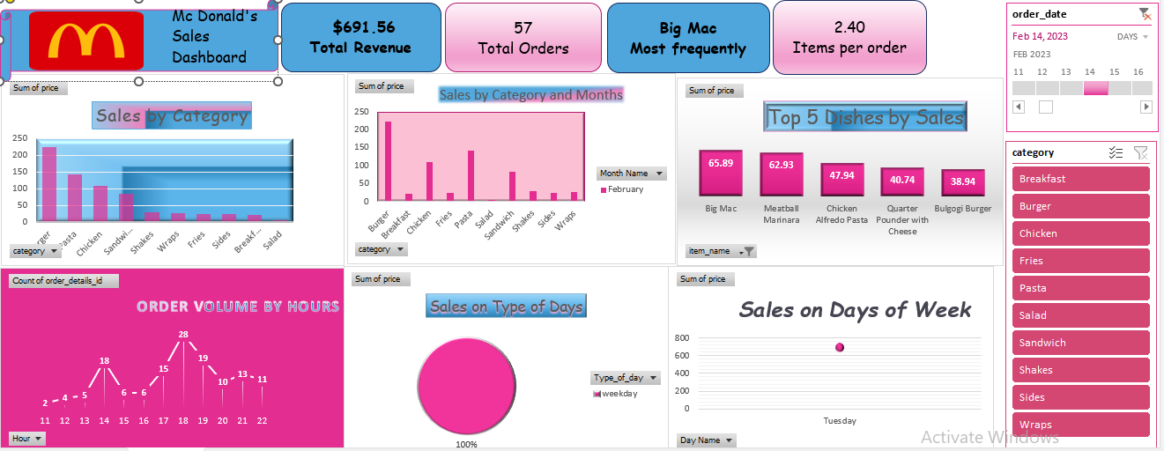
Category Performance and Valentine’s
Day Impact

Slide 6
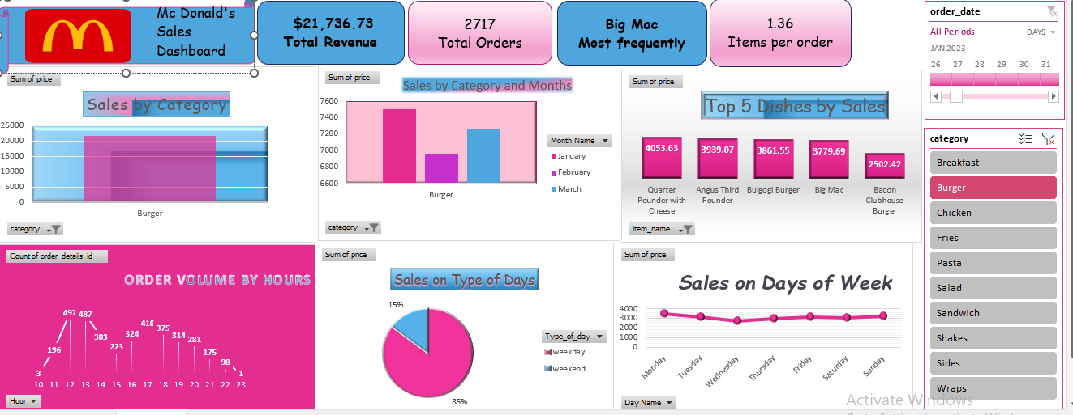
Sales analysis on Weekdays and
Burger Category Dominance

Slide 7
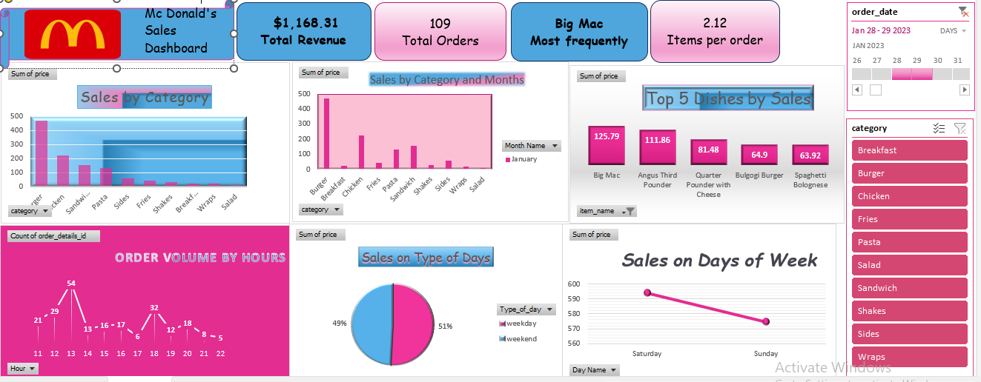
Sales analysis on Weekend

Slide 8
EXECUTIVE SUMMARY
Here's a summary of the key insights from McDonald's sales dashboard:-
Total Revenue: $61,716.91
Total Orders: 5370
Average Items per Order: 2.28
Most Frequently Ordered Item: Big Mac
Sales Insights by Time Periods
· Jan 30 - 31, 2023 (Weekday Sales)
Revenue: $1,452.83
Total Orders: 119
Average Items per Order: 2.36
Most Sold Dish: Meatball Marinara
· Jan 28 - 29, 2023 (Weekend Sales)
Revenue: $1,168.31
Total Orders: 109
Average Items per Order: 2.12
Most Sold Dish: Big Mac
>

Slide 9
EXECUTIVE SUMMARY
Here's a summary of the key insights from McDonald's sales dashboard:-
Sales Split: 51% Weekend, 49% Weekday
·Feb 14, 2023 (Valentine’s Day)
Revenue: $691.56
Total Orders: 57
Average Items per Order: 2.40
Most Sold Dish: Big Mac
All Periods Combined (January - March)
Highest-selling Category: Burgers
·Top 5 Best-Selling Dishes:Quarter Pounder with Cheese - $4,053.63
Angus Third Pounder - $3,939.07
Bulgogi Burger - $3,861.55
Big Mac - $3,779.69
Bacon Clubhouse Burger - $2,502.42
>

Slide 10
EXECUTIVE SUMMARY
Here's a summary of the key insights from McDonald's sales dashboard:-
Order Volume Analysis:-
Peak Sales Hours:
-Lunch Rush (12 PM - 2 PM) and Dinner Rush (6 PM - 8 PM)
-Lowest orders occur early morning and late night.
Sales by Days of the Week:
-85% of total sales occur on weekdays, while only 15% on weekends.
-Monday and Tuesday see higher sales in specific periods, while Saturday and Sunday sales tend to drop.
Category Insights
-Burgers generate the highest revenue, dominating sales.
-Chicken, pasta, sandwiches, and fries follow behind as secondary contributors.
-Salads and shakes have the lowest sales.
>

Slide 11

THANK YOU

